Slide 1

The Minnesota (Job) Satisfaction Questionnaire---Its Birth, 59th Birthday, and a Potential Future
David J. Weiss
August 2022

Slide 2
The Work Adjustment Project
Began in 1959
  Continued until the early 1970s
Funded by
  U.S. Office of Vocational Rehabilitation
  Later renamed Vocational Rehabilitation Administration
  Then the Rehabilitation Services Administration
Principal Investigators
  Lloyd H. Lofquist, Former VA Counselor
  George W. (Bill) England, I/O psychologist
Project Director, René V. Dawis, 1959 – 1963
  Co-Principal investigator, 1963 - 1972
New kid on the block, Dave Weiss
  Research Assistant, 1959 -1961
  Research Fellow, 1961-1963
  Research Associate and Project Director, 1963-1970

Slide 3
The Work Adjustment Project
Purpose: To develop criteria for evaluating the outcomes of vocational rehabilitation counseling
  Good outcome = person is well adjusted in their work environment
  Poor outcome = person is not well adjusted in their work environment
How can we define work adjustment?
  Person is well adjusted if they are
    Happy with their job
    Performing well on the job
  In Work Adjustment Project language
    Happiness with their job, or aspects of it = job satisfaction
    Performing well on the job = job satisfactoriness
  So to be well adjusted an employee should be both
    Satisfied and satisfactory

Slide 4
The Work Adjustment Project
Work adjustment = satisfaction + satisfactoriness
What happens if an employee is well adjusted?
  They remain on the job
    They are happy
    They are performing well
What happens if an employee is not well adjusted?
  They don’t remain on the job
    If dissatisfied, they voluntarily leave
    If unsatisfactory, they involuntarily leave
Work adjustment, if measured
  Predicts job tenure
  Within the constraints of financial and other considerations

Slide 5
The Work Adjustment Project
Satisfaction and satisfactoriness job tenure
But how are satisfaction and satisfactoriness predicted?
  Satisfactoriness (job performance)
    Long history of prediction by U.S. Employment Service (USES)
      GATB: General Aptitude Test Battery
      OAPs: Occupational Aptitude Patterns
      Correspondence between the person and the environment
    Many other similar approaches
      Various ability tests/batteries
      Job requirements for specific occupations
  Satisfaction
    Vocational interests: Not a good predictor of job satisfaction
    Work Adjustment Project
      Vocational Needs: Preferences for job “satisifiers” or “reinforcers”
      Occupational Reinforcer Patterns: Reinforcer patterns of job environments
      Correspondence between the person and the environment

Slide 6
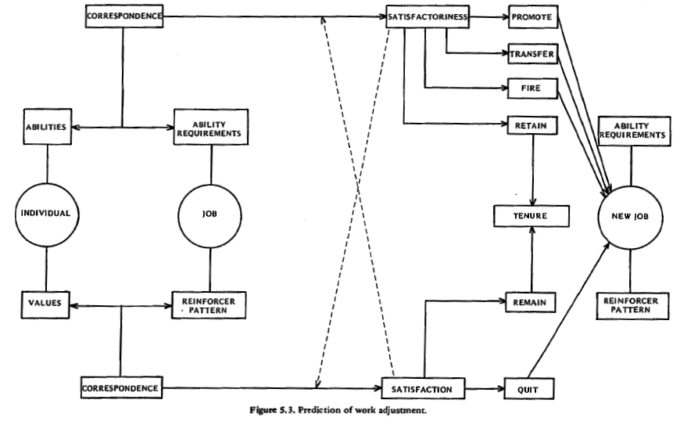
The Theory of Work Adjustment (TWA)
x

Slide 7
Instruments for The TWA
Correspondence of Abilities and Ability Requirements
  The GATB
  OAPs
  Minnesota Satisfactoriness Scales (supervisor ratings)
Correspondence of Needs/Values
  Minnesota Importance Questionnaire (MIQ)
    Measures 20 needs organized into six values
    Originally Likert-type rating scales
    Later paired comparisons with scaled zero point
  Minnesota Job Description Questionnaire
    Measures 21 occupational reinforcers/satisifers
    Uses multiple rank orders paired comparison design
    Results in Occupational Reinforcer Patterns (ORPs)
    Developed 185 ORPs for major occupations
  Minnesota Satisfaction Questionnaire

Slide 8
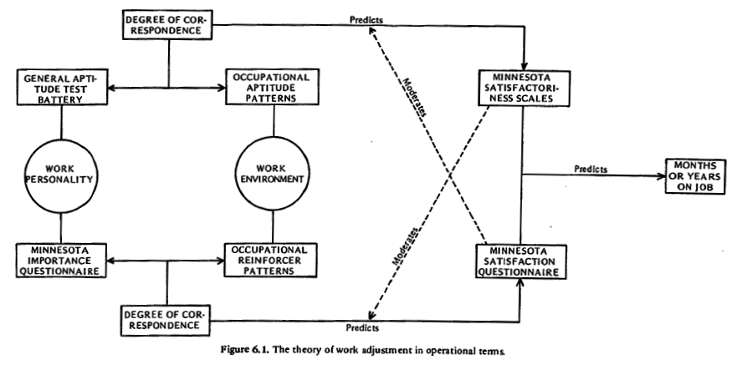
Instruments for
The Theory of Work Adjustment

Slide 9
Minnesota Satisfaction
Questionnaire (MSQ)
Was the starting point for our major work on
  Needs/reinforcer correspondence
Defined the set of 20 scales
  Satisfiers (MSQ)
  Person occupational needs (MIQ)
  Environmental occupational reinforcers (need satisfiers—MJDQ)
MSQ scales based on
  The job satisfaction literature in 1959
  Some of our own ideas
The MSQ once developed remained essentially constant
  With one psychometric modification
  To improve its measurement characteristics
Most effort went into the MIQ and MJDQ/ORPs

Slide 10
Minnesota Satisfaction Questionnaire (MSQ)
20 Scales of the MSQ (and MIQ and MJDQ)
  Ability Utilization Moral Values
  Achievement Recognition
  Activity Responsibility
  Advancement Security
  Authority Social Status
  Company Policies Social Service
  Compensation Supervision--Human Relations
  Co-workers Supervision--Technical
  Creativity Variety
  Independence Working Conditions
Long form MSQ: 5 items per scale
Short form MSQ: 1 item per scale

Slide 11
Minnesota Satisfaction Questionnaire (MSQ)
20 Scales of the MSQ (and MIQ and MJDQ)
  Ability Utilization Moral Values
  Achievement Recognition
  Activity Responsibility
  Advancement Security
  Authority Social Status
  Company Policies Social Service
  Compensation Supervision--Human Relations
  Co-workers Supervision--Technical
  Creativity Variety
  Independence Working Conditions
Factor analyses supported two factors
  Intrinsic satisfaction (red)
  Extrinsic satisfaction (blue)
And a General Satisfaction Scale

Slide 12
Minnesota Satisfaction Questionnaire (MSQ)
Original long and short forms: 1963
  Item rating scale
    Very Dissatisfied
    Dissatisfied
    "N" (Neither Satisfied nor Dissatisfied)
    Satisfied
    Very Satisfied
  Revised and republished in 1977
    Made “gender inclusive”
    “his men” changed to “his/her employees”
    “him” changed to “him/her”
  Psychometric problem
    Most response were in the last three categories
    Item response distributions very skewed

Slide 13
Minnesota Satisfaction Questionnaire (MSQ)
MSQ 1967 revision
  Changed item response options to
    Not Satisfied
    Somewhat Satisfied
    Satisfied
    Very Satisfied
    Extremely Satisfied
  Result was response distributions that centered around “Satisfied”
    No skewness for most items
    Resulted in scores with a wider range
    Better able to reflect individual differences
  But we never published normative data for it

Slide 14
Minnesota Satisfaction Questionnaire (MSQ)
Original 1963/1977 version has most data
Manual has 101 pages
  High internal consistency reliabilities across many jobs
    Highest average group all in the 0.90s
    Lowest average group in the 0.70s. Range 0.59 to 0.87
  Good test retest reliabilities (stabilities) over
    One week—most in the 0.80s, highest 0.90
    One year—most in the 0.60, range 0.40 to 0.89
  Factor analysis results for 14 different occupations
  Occupational differences across all scales
  Normative data for 25 occupations
      Across the full occupational spectrum
        Professional, Technical, Managerial
        Through Laborers

Slide 15
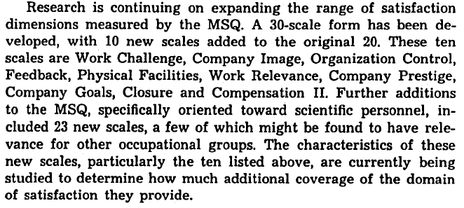
MSQ Plans as of 1967 (!)
Excerpt from the 1967 Manual
Unfortunately, although some of this work was done, it has been lost in history

Slide 16
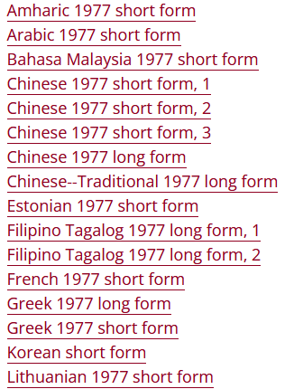
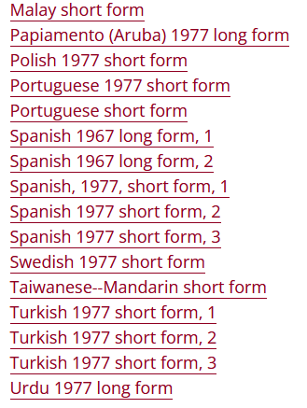
Current Status of the MSQ
It has been translated into at least the following non-English forms

Slide 17
Current Status, continued
We made the MSQ available for research use on our Web site
  Vocational Psychology Research
  https://vpr.psych.umn.edu
  Required permission to use it
  About 8 or 9 years ago made it available under a Creative Commons Research License
  One publication tracking service on the Web reports
    Over 5,300 reads
    Over 1,900 citations
    I continue to receive 1 or 2 requests a week
  Web site also includes
    Two books on the Theory of Work Adjustment
    All the Work Adjustment Project instruments
    30 Research monographs, including manuals for all instruments

Slide 18
The Future: Content Issues
We need to identify a group (or person) who is interested in updating the MSQ
Some issues:
  What’s the state of job satisfaction research today?
  Are the 20 satisfaction scales still relevant?
  What new aspects of job satisfaction have emerged over 50+ years?
  Is the item text of all the scales still appropriate?
  Are there dimensions of job satisfaction that are specific to
    Recently emerged occupations?
    Emerging occupations?

Slide 19
The Future: Psychometric Issues
We need someone with a modern psychometric orientation to update the MSQ’s psychometrics
I’ve spent the last 50 years doing advanced psychometrics
If I were going to develop the MSQ today
  Here’s what I would do:
    Not score my scales using arbitrary 1 – 5 weights!
    Analyze my data using modern measurement methods
  Why?
    Because Likert weights (e.g., 1 – 5)
      Are completely arbitrary
      Are NOT based on data
    They are the only measurement method that is NOT data-based!!

Slide 20
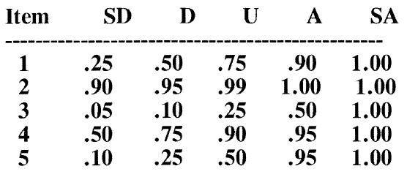
Likert Scaling:
How Did it End Up With Arbitrary Weights?
Originally Likert developed weights for each item from empirical data:
His calculated weights looked something like this for each item
But negative numbers were difficult to work with, so he subtracted the lowest weight from the others and got

Slide 21
Likert Scaling:
How Did it End Up With Arbitrary Weights?
But decimal points were also difficult to deal with, so he rounded the decimal weights
to the nearest integer
But in 1934, there were no computing facilities
So in 1934 he did a small study comparing his empirical item weights with arbitrary 1-5 weights
  In terms of internal consistency reliability
  Found no difference in reliability
And 88 years later everyone uses arbitrary weights!!!!

Slide 22
A Possible Psychometric Future
Use modern measurement methods
Item response theory (IRT)
  Formalized beginning in 1968
  Expanded considerably since
  Requires computers for its implementation
    But they’re everywhere now
    Your smartphone has far more computing power than the University of Minnesota had in the 1960s and early 1970s
IRT has a number of advantages over assigning arbitrary weights to item responses. e.g.,
  It is fully data-based
  It provides a meaningful analysis of how each item functions
  It provides better and more meaningful scores
  It provides a measure of the precision of each score

Slide 23
Why Are IRT Scores Better?
If you use the MSQ to measure 50 employees on a single 5-item 5-option (1 - 5) scale
  Question: How many distinctions can you make among those 50 employees?
  Answer: 21 – scores range from 5 to 25 on each scale
If you use the MSQ to measure 500 employees on a single 5-item 5-option scale
  Question: How many distinctions can you make among those 500 employees?
  Answer: 21 – scores on a single scale still range from 5 to 25
If you use the MSQ to measure employees on a single 5-item 5-option scale, and score it by IRT
  Question: How many distinctions can you make among those employees?
  Answer: 5 × 5 × 5 × 5 × 5 = 3,125
  Which is a few more than 21!

Slide 24
IRT Versus Summed Scores
Q: How does IRT accomplish this greater capability of describing individual differences?
A: It uses each person’s pattern of responses
  In conjunction with the data-based characteristics of each response option for each item
    So a respondent who answers chooses the “2” option for item 1 and the “4” option for item 2
    Gets a different IRT score than someone who selects option “4” for item 1 and option “2” for item 2
    Even though they get the same summed score (i.e. 6)
  This process continues for all items
  And the psychometrically (i.e., data-based) derived weights using IRT for each option of each item can all differ
  So for each sum score, there can be multiple IRT scores

Slide 25
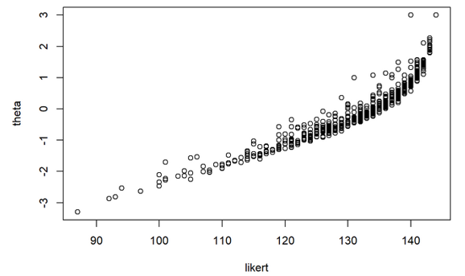
IRT Versus Summed Scores: Example 1
36-Item Likert scale with 4 response options
Summed (Likert) scores ranged from 87 to 144 (58 distinctions among respondents)
IRT scores resulted in 385 different scores

Slide 26
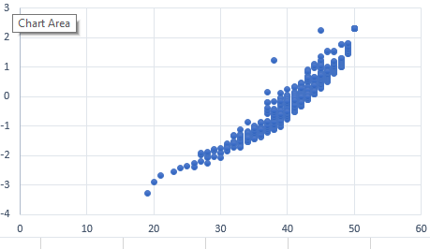
IRT Versus Summed Scores: Example 2
A 10-Item 5-option “Big Five” Personality Scale
Theta
For sum scores of 28 through 49 there is clearly a range of IRT scores
In many cases ranging a full standard deviation on the IRT scale
Sum Score

Slide 27
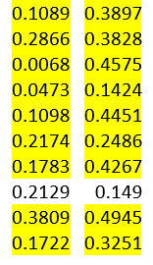
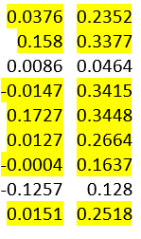
Advantages of IRT Scores
Can make more distinctions among individuals
Can make finer distinctions among individuals
Result is larger variances
  Which can result in better predictions
  And/or better data analyses
Example: Test item analyses (point-biserial correlations) sum theta sum theta

Slide 28
IRT’s Second Score Advantage
An individual measure of (im)precision associated with each score–the standard error of measurement (SEM)
NOT the same as the SEM from classical measurement methods
  Classical SEM is constant for a group
  Based on the group’s characteristics
    Reliability
    Score variance
IRT SEM
  Unique to an individual’s response pattern
  Not related to group characteristics
  Results from the IRT scoring process for an individual
  Varies from person to person

Slide 29
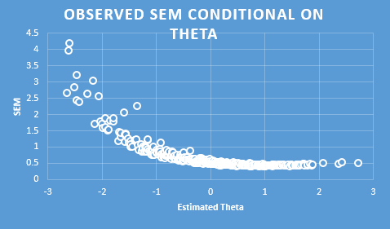
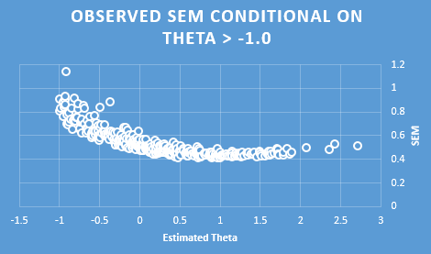
Observed SEMs: 26 Items, N = 500

Slide 30
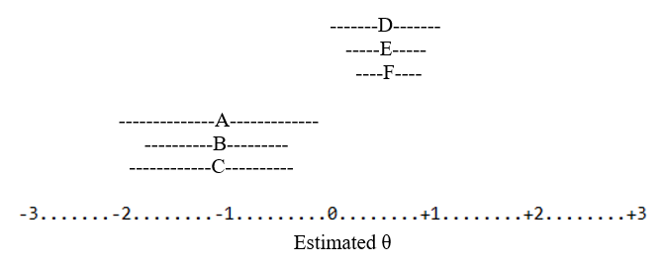
θ Estimates with SEM Bands
Reflects the precision in a score
Tells us who our tests is measuring well or poorly

Slide 31
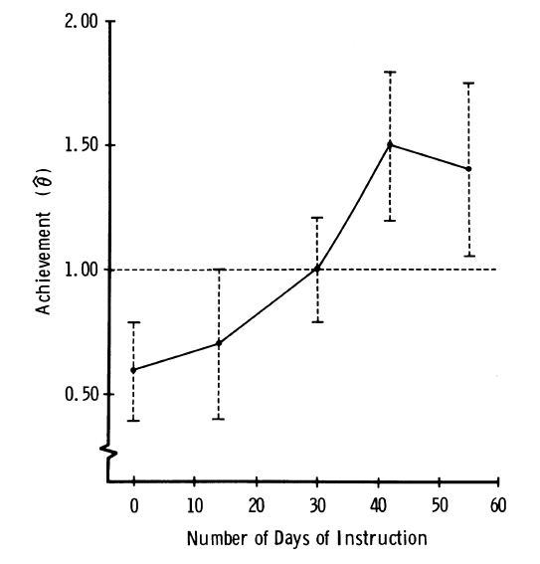
SEM Confidence Intervals Can be Used to Measure Change and
Determine Whether it is Significant
Significant change occurs when the confidence interval around a does not overlap the confidence interval around a prior
are different from
are different from

Slide 32
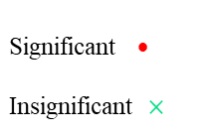
Significant vs. Nonsignificant Individual Change Over Three Occasions
Significant • Insignificant $×$
Notes:
Make a point at mentioning the significant negative change and possible explanations for it

Slide 33
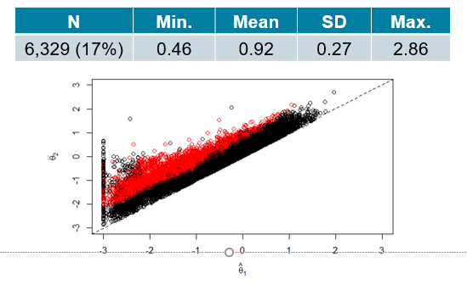

Psychometrically Significant Positive Change
Over Two Occasions
${ θ}_{2}−θ_{1}>0$ significant

Slide 34
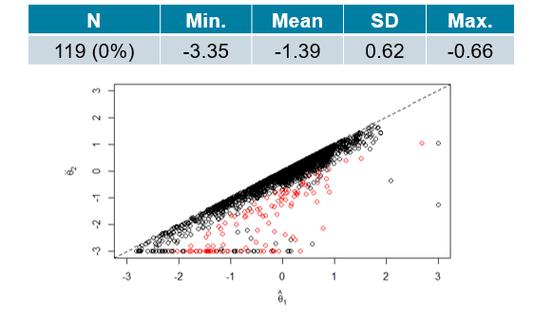

Psychometrically Significant Negative Change
${ θ}_{2}−θ_{1}<0$ significant

Slide 35
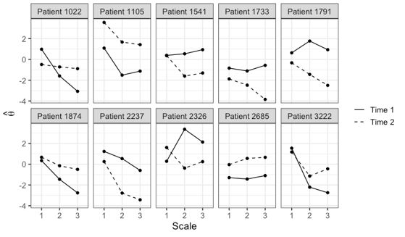
Some Significant Patterns of
Two Occasion Multivariable Change (27%)

Slide 36
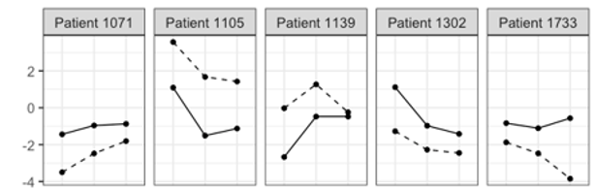

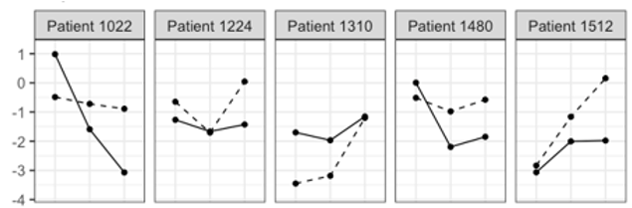
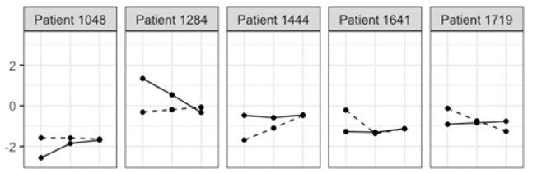
Psychometrically Significant Differences in Level, Scatter, and Shape
Level
Scatter
Shape

Slide 37
IRT’s Third Score Advantage
In classical test theory, correlational validity is limited by score reliability (a group statistic)
  Higher reliability → higher (potential) validity
  Lower reliability → (potential) lower validity
  Is the correction for “attenuation”
But reliability is not an IRT concept
  It is replaced by score (im)precision conditional on a θ estimate = the observed SEM
Can observed SEMs can be used to enhance prediction?

Slide 38
Improving Predictions with IRT SEMs
Correlational validities are low for all three criteria
 | Criterion 1 |  |  | Criterion 2 |  |  | Criterion 3
Group | N | r |  | N | r |  | N | r
Total | 975 | 0.267 |  | 690 | 0.160 |  | 1684 | 0.192

Slide 39
Improving Predictions with IRT SEMs
There is a bit of a moderator effect for Criterion 1
 | Criterion 1 |  |  | Criterion 2 |  |  | Criterion 3
Group | N | r |  | N | r |  | N | r | R
Total | 975 | 0.267 |  | 690 | 0.160 |  | 1684 | 0.192
Very low SEM | 272 | 0.409
Low SEM | 245 | 0.326
High SEM | 270 | 0.246
Very High SEM | 188 | 0.240

Slide 40
Improving Predictions with IRT SEMs
 | Criterion 1 |  |  | Criterion 2 |  |  | Criterion 3
Group | N | r |  | N | r |  | N | r
Total | 975 | 0.267 |  | 690 | 0.160 |  | 1684 | 0.192
Very low SEM | 272 | 0.409 |  | 191 | 0.327
Low SEM | 245 | 0.326 |  | 169 | 0.229
High SEM | 270 | 0.246 |  | 189 | 0.192
Very High SEM | 188 | 0.240 |  | 141 | 0.075
There is a bit of a moderator effect for Criterion 1
A slightly stronger moderator effect for Criterion 2

Slide 41
Improving Predictions with IRT SEMs
There is a bit of a moderator effect for Criterion 1
A slightly stronger moderator effect for Criterion 2
A very strong moderator effect for Criterion 3
 | Criterion 1 |  |  | Criterion 2 |  |  | Criterion 3
Group | N | r |  | N | r |  | N | r
Total | 975 | 0.267 |  | 690 | 0.160 |  | 1684 | 0.192
Very low SEM | 272 | 0.409 |  | 191 | 0.327 |  | 438 | 0.592
Low SEM | 245 | 0.326 |  | 169 | 0.229 |  | 382 | 0.498
High SEM | 270 | 0.246 |  | 189 | 0.192 |  | 473 | 0.417
Very High SEM | 188 | 0.240 |  | 141 | 0.075 |  | 391 | 0.366

Slide 42
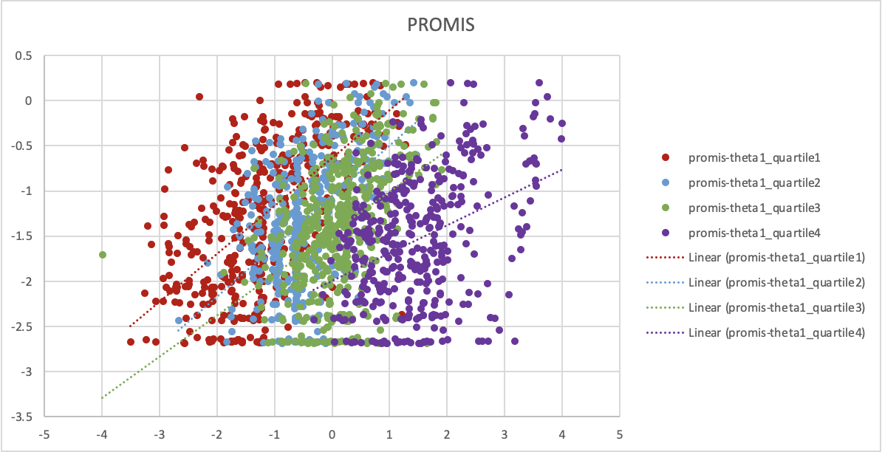
How does the SEM Result in a Moderator Effect?
This is a bivariate “mixture distribution” of the correlations for Criterion 3 (PROMIS)
The moderator effect simply “unpacks” that mixture

Slide 43
Improving Predictions with IRT SEMs
IRT SEM also functions as a suppressor variable
When predicting Criterion 3 using moderated regression, R = 0.574 for the total group
 | Criterion 1 |  |  | Criterion 2 |  |  | Criterion 3
Group | N | r | R | N | r | R | N | r | R
Total | 975 | 0.267 | 0.331 | 690 | 0.160 | 0.221 | 1684 | 0.192 | 0.481
Very low SEM | 272 | 0.409 | 0.431. | 191 | 0.327 | 0.350 | 438 | 0.592 | 0.646
Low SEM | 245 | 0.326 | 0.326 | 169 | 0.229 | 0.233 | 382 | 0.498 | 0.511
High SEM | 270 | 0.246 | 0.3 | 189 | 0.192 | 0.220 | 473 | 0.417 | 0.490
Very High SEM | 188 | 0.240 | 0.299 | 141 | 0.075 | 0.078 | 391 | 0.366 | 0.502

Slide 44
A Potential Future for the MSQ
Modern psychometrics—IRT—can improve the MSQ
  Provide option scoring weights that provide better scores
  Provide item selection criteria that result in improved scale characteristics
  Provide examinee scores that can differentiate a wider range of individual differences
  Increase score variability with potential increases in correlational validity
  Provide error bands around individual scores to facilitate use and communication
  Implement the ability to measure and test the psychometric significance of individual change and inter-individual differences
  Improve predictive validities by use of SEMs as moderators and/or suppressors
  Improve test efficiency and score precision using computerized adaptive testing

Slide 45
For Further Information
MSQ, TWA, etc.
https://vpr.psych.umn.edu
Anything else
djweiss@umn.edu

Slide 46


